Slide 1
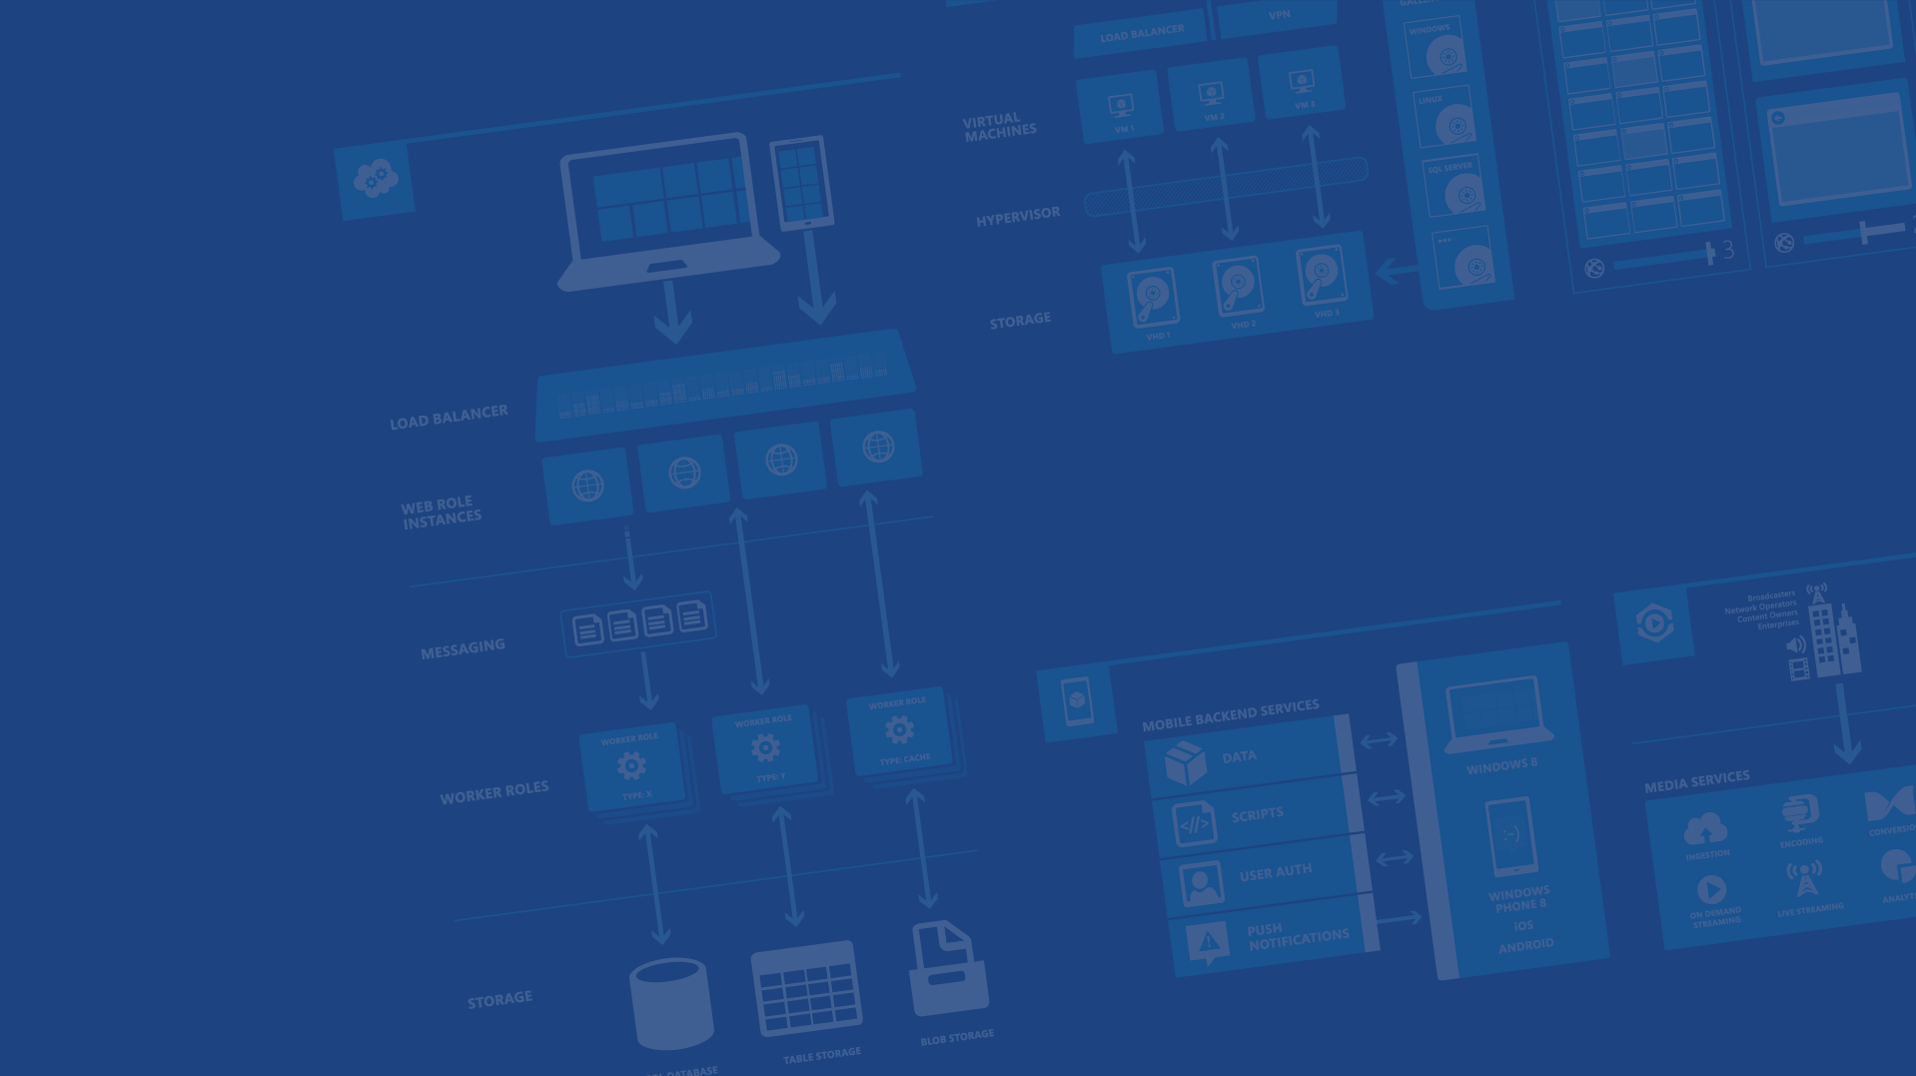
Azure Websites
Marc Gagne
Startup Lead & Sr. Technical Evangelist – Microsoft Canada
@marc_gagne - marc.gagne@microsoft.com

Slide 2
Agenda
Site creation
Language Support
Deployment
Source Control Integration
Scale
Web Jobs
Site Slots
Traffic Manager
Backup
Hybrid Connections
Other PaaS Services
Notes:
Slide Objectives:
No need to read off everything, the goal is to explain that we will be diving into many aspects of Websites, beyond just getting one setup!

Slide 3
The cloud?
Hosting models
On Premises / Colo
Infrastructure
(as a Service)
Platform
(as a Service)
Applications
Applications
You manage
Applications
You scale, make
resilient & manage
You scale, make resilient and manage
Data
Data
Data
Runtime
Runtime
Runtime
Middleware
Middleware
Middleware
Scale, resilience and management by vendor
O/S
O/S
O/S
Virtualization
Virtualization
Managed by vendor
Virtualization
Servers
Servers
Servers
Storage
Storage
Storage
Networking
Networking
Networking
Notes:
Slide Objectives:
Quick overview of the evolution / state of affairs of the cloud
Old: On premises or colo-location server
You have to manage EVERYTHING yourself from physical hardware, cooling, networking, power etc.
Modern Cloud: The majority of todays cloud is IaaS, all the benefits of on-prem/colo (i.e an actual server) without having to deal with hardware, networking, redundant power/bandwidth etc.
Future is in PaaS with Azure in the lead. PaaS services like Azure Websites means you can focus on the core of your business without having to deal with setting up and patches Oss, updating your middleware & runtime (.Net, PHP, Python etc.) all while benefiting from someone else managing server issues and scale

Slide 4

Develop apps with…
.NET
Python
Node.js
Java
PHP
Notes:
Slide Objectives:
The goal of this slide is to setup the mindset that we are not just talking about Microsoft stacks only, but rather a more inclusive scenario of developing in THEIR preferred language and deployment strategy
Azure websites (does it’s best) to get out of the way and not enforce any one particular convention

Slide 5

Choose your own (deployment) Adventure!
Visual Studio
Online
CodePlex
Git
GitHub
BitBucket
DropBox
FTP
Notes:
Slide Objectives:
Re-enforce that Azure works with many popular deployment strategies including Git, GitHub, DropBox, and of course VSO & FTP

Slide 6
Demo
Azure Website Creation
Notes:
Demos
Demos\001 - Azure Websites Creation\portal-overview.html
Demos\001 - Azure Websites Creation\wordpress-demo.html
Demos\001 - Azure Websites Creation\ftp-demo.html
Demos\002 - Node.js, Git & Azure Websites\node-git-azure-websites.md

Slide 7
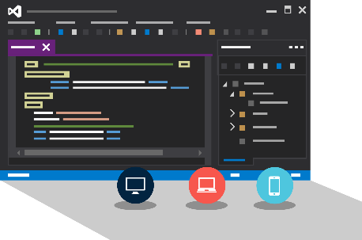
Visual Studio + Azure Websites
Create Azure Resources during File / New
Create Azure Website during deploy
Manage with Server Explorer
Notes:
Slide Objectives:
Setup next demo which is to show how easy it is to deploy & manage Azure right from VS

Slide 8
Demo
Visual Studio Support
Notes:
Demos:
Demos\003 - Visual Studio & Azure Websites\visual-studio-websites-demo.html

Slide 9
Scale

Slide 10
Manual Scaling
Instance Count
1
6
Instances
Notes:
Slide Objectives:
Compare the current IaaS scale methods of having to scale up (bigger servers) or scale out (more servers) which requires load balancing, deploying to many servers and ensuring they are in sync etc.
PaaS makes it as easy as moving a slide to scale out and will even create and configure a load balancer for you

Slide 11
AutoScale
Notes:
Slide Objectives:
What’s better than scaling your site yourself by moving a slider bar? Having Azure do it for you automatically!

Slide 12
AutoScale
Notes:
Slide Objectives:
Inform the audience that Azure will monitor your websites CPU load (every 5 minutes) and when needed will scale up as per for configuration (max # of instances)

Slide 13
AutoScale

Slide 14
Auto-Scaling
Instance Count
2
6
Instances
CPU
60
80
Percent
Notes:
Slide Objectives:
Autoscaling allows you to set the min & max # of instances to have running (minimum is two as then you have redundancy and higher uptime)
Azure monitors the CPU (every 5 minutes) and uses the min/max threshold to determine when to scale up or down your site as needed

Slide 15
Demo
Manual Scale
Scheduled Scale
Auto Scale
Notes:
Demos
Demos\004 - Scaling Azure Websites\scaling-websites-demo.html

Slide 16
Auto-Scale Considerations
Only Scales the Web Tier
Scale Up/Down is not instantaneous
~ 5 minutes
Notes:
Slide Objectives:
Remind the audience that this will only scale their web tier, not their middle tier or backend (database), though there are ways to do that using web/worker roles (cloud services) and Azure SQL

Slide 17
Site Slots (aka staging)
Notes:
Slide Objectives:
Setup the next section by explaining that a typical website or web app has multiple stages which can include development, testing, beta or pre-production and finally production
Azure Websites helps manage this by using site slots

Slide 18
Staging
Notes:
Slide Objectives:
Explain that this represents a typical website setup

Slide 19
Staging

Slide 20
Staging
Notes:
Slide Objectives:
Staging (or site slots) allows you to create multiple version of your site

Slide 21
Staging
Notes:
Slide Objectives:
Each stage (in this case production & staging) can be tied to the appropriate branch in your source control repository
It’s important to call out that depending on how they configure their site they can have two version of the website using the same database (handy for say beta environments)

Slide 22
Demo
Staging
Notes:
Demos
Demos\005 - Azure Websites Deployment Slots\azure-websites-staging-demo.html

Slide 23
Web Jobs
Notes:
Slide Objectives:
What kind of jobs are suitable for “web jobs”, things like clearing out temporary uploads, or validating and manipulating (creating thumbnails) of user uploaded photos, or jobs to go pull 3rd party data feeds such as from Twitter.
Basically webs jobs is for anything you would have otherwise created a cron job or Windows service for

Slide 24
WebJobs
Notes:
Slide Objectives:
Explain that Web jobs rely on queues, as requests come in if there is work you’d like to do in the background you send it to the queue
Example: User uploads a photo, but you want to respond (200 OK) asap, so you store a message in the queue with the path to the image for processing (verification, creation of thumbnails etc.)

Slide 25
WebJobs
Notes:
Slide Objectives:
Explain that the web jobs reads from the queue and processes it as required
Code (for the jobs) can be updated as
cmd, .bat, .exe (using windows cmd)
.ps1 (using powershell)
.sh (using bash)
.php (using php)
.py (using python)
.js (using node)

Slide 26
Traffic Manager
Notes:
Slide Objectives:
When you have a website with more than one instance in the same cloud service, Azure provides free load balancing using round robin
For more advanced features including failover, performance & round robin balancing across different DCs or GEOs you’ll want to use Traffic Manager

Slide 27
14 regions worldwide in 2014
Azure
Websites footprint
Notes:
Slide Objectives:
Explain that Azure Traffic Manager allows you to scale across 14 regions and select the best setup for your needs be it round robin, failover or highest performance for your users

Slide 28
Intelligent customer routing with Traffic Manager
www.yourapp.com
Notes:
Slide Objectives:
Show how traffic manager automatically handles instances failing and new instances being applied

Slide 29
Intelligent customer routing with Traffic Manager
www.yourapp.com
Notes:
Slide Objectives:
Show how traffic manager automatically handles instances failing and new instances being applied

Slide 30
Backup
Notes:
Slide Objectives:
Explain that even though you are using source control you should still backup your website including user uploaded media, log files, databases, configuration files etc.

Slide 31
Backups
Websites Files
Websites Settings Manifest
Database (Optional)
Notes:
Slide Objectives:
Explain that even though you are using source control you should still backup your website including user uploaded media, log files, databases, configuration files etc.

Slide 32
Demo
Backup
Notes:
Demos
Demos\006 - Azure Websites Backups\azure-websites-backups-demo.html

Slide 33
Hybrid Connections
Notes:
Slide Objectives:
Explain that although we think everything should be in the cloud, that’s not always feasible for some folks. For this we have hybrid connections, which is like a VPN in that it is secure end to end, but much simpler,

Slide 34



Hybrid Connections
Corporate Network
Microsoft SQL Server
Web Sites
Hybrid Connection Manager
Other published resources
Hybrid Connection
Mobile Services
Notes:
Slide Objectives:
Explain that using BizSpark & listener services on presmise you can connect Azure to any TCP service securely using HTTPS tunneling
Details
Uses BizTalk
You must install a listerner on the secure side (on premise)
Can connect to any TCP service (web server, SQL Etc.)
For when you don’t want to have to setup a full hardware VPN
Safely and securely connect two datacenters
Secure HTTPS Tunnel

Slide 35
Application Insights
Notes:
Slide Objectives:
Explain that Azure Insights allows you to Detect issues, solve problems and continuously improve your web applications.

Slide 36
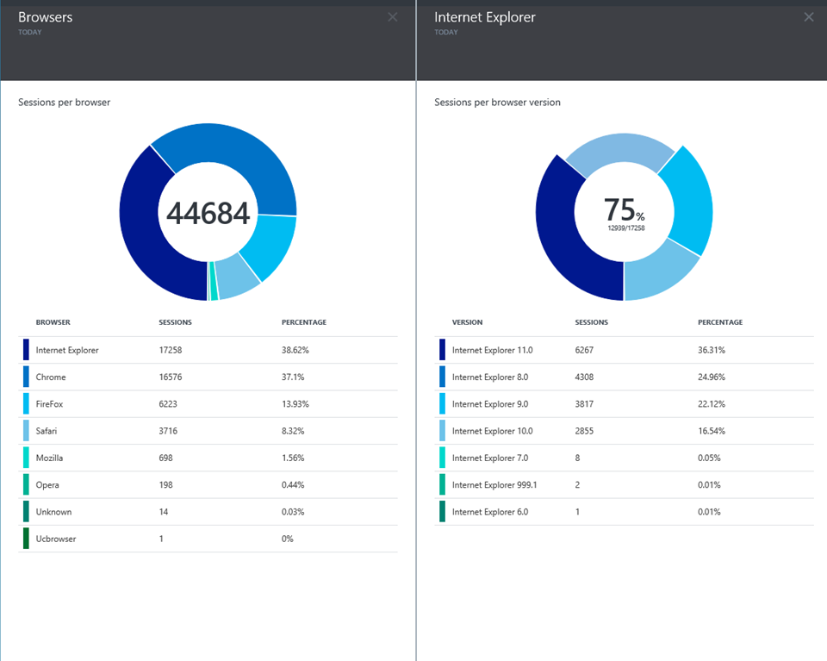
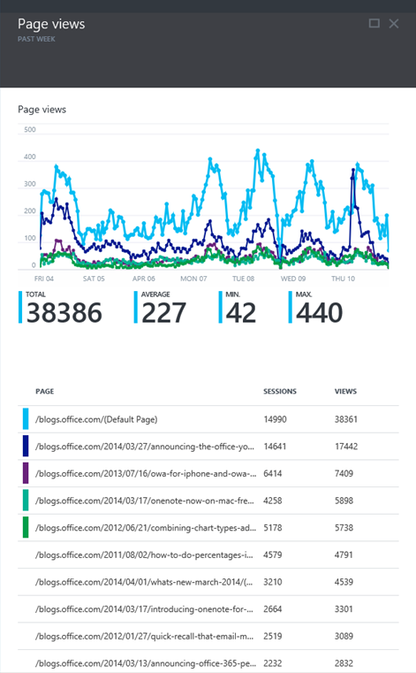
Application Insights
Notes:
Detect issues, solve problems and continuously improve your web applications
Availability, performance monitoring and alerts
Track adoption and usage with pages, events & metrics
Search traces and exception logs for failure diagnosis
Support for ASP.NET apps and HTML websites
Add to new or existing projects with Visual Studio 2013
Get telemetry for existing apps without redeploying

Slide 37
“and all that PaaS…”
Notes:
Slide Objectives:
Explain that Azure Websites isn’t the only Platform as a Service offering on Azure, in fact we are the leaders in PaaS offerings

Slide 38


Microsoft Azure Services
Access Control
Layer
AD
Multifactor
Authentication
BizTalk Services
Service Bus
CDN
Traffic Manager
Virtual Networks
Express Route
Integration
layer
API Mgmt
Mobile Services
Websites
Cloud Services
VM
Media Services
Notification Hubs
Scheduler
Automation
Application
layer
Blobs
Tables
Queues
SQL Database
Machine Learning
HD Insight
Caching
Backup and Recovery
StorSimple
Data Layer
Notes:
Slide Objectives:
Explain that asides from Virtual Machines (IaaS) most of Azure is PaaS which means you can treat it like a set of building blocks that you can use to construct your product while focusing on your core business by not developing solutions such as an account solution (AD), security (AD, Multifactor Authentication), Mobile back end (Mobile services), Notification systems (Notification Hubs) etc.

Slide 39
How to get started
Notes:
Slide Objectives:
Explain that Azure Websites isn’t the only Platform as a Service offering on Azure, in fact we are the leaders in PaaS offerings

Slide 40
Try $200 Azure Trial aka.ms/azuretrial
Read documentation azure.com
Watch 10 minute videos friday.azure.com
Train Virtual Academy aka.ms/cloudmva

Slide 41
Startups
Notes:
Slide Objectives:
Explain that beyond the free trial we have a pretty awesome program for startups

Slide 42

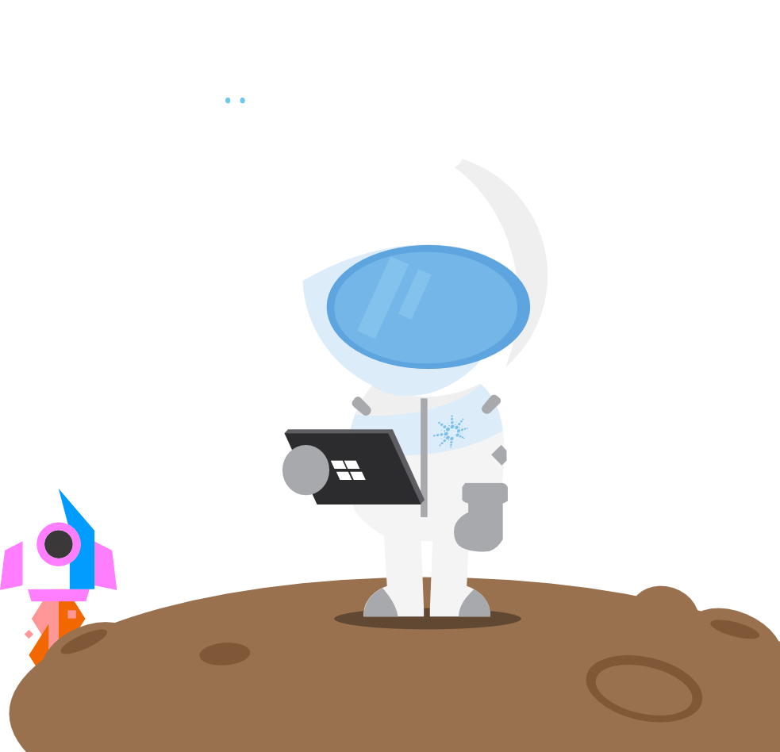

BizSpark
Notes:
Slide Objectives:
Explain that BizSpark is the name of the program (set of offers) we have for tech startups
Video:
Watch this video (http://aka.ms/bizsparkvid) to get familiar with BizSpark and our offers

Slide 43
BizSpark is for tech startups
Who are developing software/technology for themselves
Who are less than 5 years old
Who are making less than one million in revenue annually
Who are privately held
Notes:
Slide Objectives:
Explain that BizSpark is for tech startups who are developing 1st party IP/Hardware/Software.
The #1 reason startups are denied their application to BizSpark is that they are consultants/contract workers etc.
In short if you company is developing something it will sell (not on a contract for someone else) then you are set.

Slide 44
BizSpark is not for startups
Who are consultants
Who primarily do contract work
Who primarily do IT Services
Who design/build websites
Notes:
Slide Objectives:
Explain that these are the common reasons a startups application is denied from BizSpark
We get asked “what if a consulting/contracting company otherwise meets all the requirements as they are now working on a 1st party app. The answer is connect with us (bizsparkca@Microsoft.com) as we can make an exception provided the benefits we give them only apply to that work.

Slide 45



What do BizSpark startups get?
Notes:
Slide Objectives:
Explain that the core of the benefits include cloud credits, free MS software & access to a loaner pool of devices for dev/test.

Slide 46









$150/month for 3 years in Azure Credits
Virtual Machines
Windows & Linux
Website & Web Apps
.NET, Node.js, PHP, Python & more
Publish with Git, GitHub, FTP & more
Mobile Services
Identity, Notifications, Storage & more
Windows, iOS, Android & Web
40% Discount on paid usage
Notes:
Slide Objectives:
Key points to hit are
$150 a month in azure credits (per developer) while an active member of BizSpark (max 3 years)
There are Windows and Linux virtual machines on Azure including ready to deploy images of Windows Server, Ubuntu, CentOS and more.
Websites (PaaS) support for .NET, Node.js, PHP, Python and more
Mobile Services for iOS, Android, Windows & Web
If you go past the credits you get a 40% discount on paid usage

Slide 47
Free Software & Services for 3 years
MSDN Ultimate Subscriptions (~$13,000 each)
Windows
Visual Studio Ultimate
Office 2013
Office 365 Developer Subscription
Visual Studio Online
Developer Store accounts
& more
Notes:
Slide Objectives:
Key points to hit are
The core of the BizSpark offer is free MSDN Ultimate Subscriptions (again one per developer)
Normally these sell for over $13,000 each to our enterprise customers
Startups get them for free!

Slide 48
BizSpark Plus (Azure 60k Offer)
$5,000/month for one year in Microsoft Azure credits
Must be an active BizSpark member
Must be consuming $500+/month in any cloud (Amazon, Google etc.)
Must be nominated by partner or Microsoft
Learn more @ aka.ms/azure60k
Notes:
Slide Objectives:
Key points to hit are
BizSpark Plus (aka the Azure 60k) is for BizSpark startups who are/need more than $500 a month in azure
We can offer this even if they are on another cloud provider as long as they commit to migrating to Azure
It’s by nomination only

Slide 49



More developers == more benefits
BizSpark Admin /
Developer 1
$150/month in Azure Credits
Free Microsoft Software etc.
MSDN Subscription
BizSpark
$150/month in Azure Credits
Free Microsoft Software etc.
Developers 2+
MSDN Subscription
Notes:
Slide Objectives:
Explain that the benefits scale when they add more developers
Each developer gets their own MSDN subscription (and therefore their own benefits) including their own Azure subscription

Slide 50
Maximize your benefits
Use one Azure subscription for dev
Use another Azure subscription for production
Use another Azure subscription for betas, previews and custom demos
If 4 isn’t enough you can always request more by emailing bizspark@microsoft.com
Notes:
Slide Objectives:
Explain that you can have one developer apply their benefits towards a dev environment, another to a test env, another to a production env
Need more? Just email bizspark and explain why

Slide 51












Join the over 2,800 tech startups benefiting from BizSpark & Microsoft Azure today
Fhotoroom
Notes:
Slide Objectives:
Explain that over 2800 startups are active or have graduated through the program!
Currently there are over 1900 startups active in the program (03.16.2015)
Feel free to edit the startups being shown to highlight local ones

Slide 52

thank you
Join bizspark.com
Learn aka.ms/bizsparkguide
Connect bizsparkca@microsoft.com

Slide 53
Thank You!
@marc_gagne

Slide 55


Get started
Visit azure.microsoft.com

Slide 56
Web Sites Service Architecture
Deployment
Server(s)
File Server
Publish Endpoint
Blob Storage
Application Database
Frontend (IIS ARR)
Microsoft Azure
Load Balancer
Metering
Runtime Database
API Endpoint

Slide 57
Debug Console (Kudu)
Environment
Debug Console
Diagnostics & Logs
Web Hooks
REST API
https://[website-name].scm.azurewebsites.net

Slide 58
Web Site
Web Site
Monaco
MSDeploy
Build/Upload Your Own
Kudu
Web Jobs
Gallery
Public Site Extensions
Private Site Extensions
Microsoft Azure Web Site

Slide 59
Customizing the Deployment
>: azure site deploymentscript –h
help:
help: Generate custom deployment script
help: Usage: site deploymentscript [options]
help:
help: Options:
help: --aspWAP <projectFilePath>
help: --aspWebSite
help: --node
help: --php
help: --python
help: --basic
Microsoft Azure Cross Platform Command-Line Tools

Slide 61
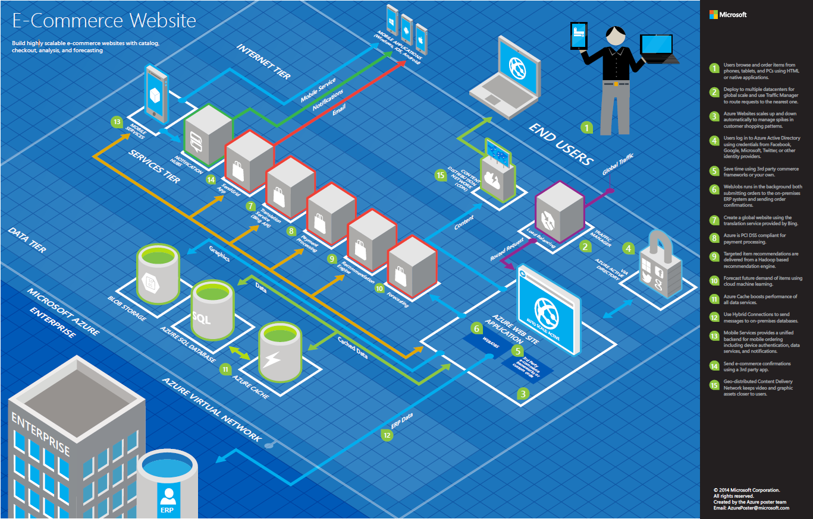

Slide 62
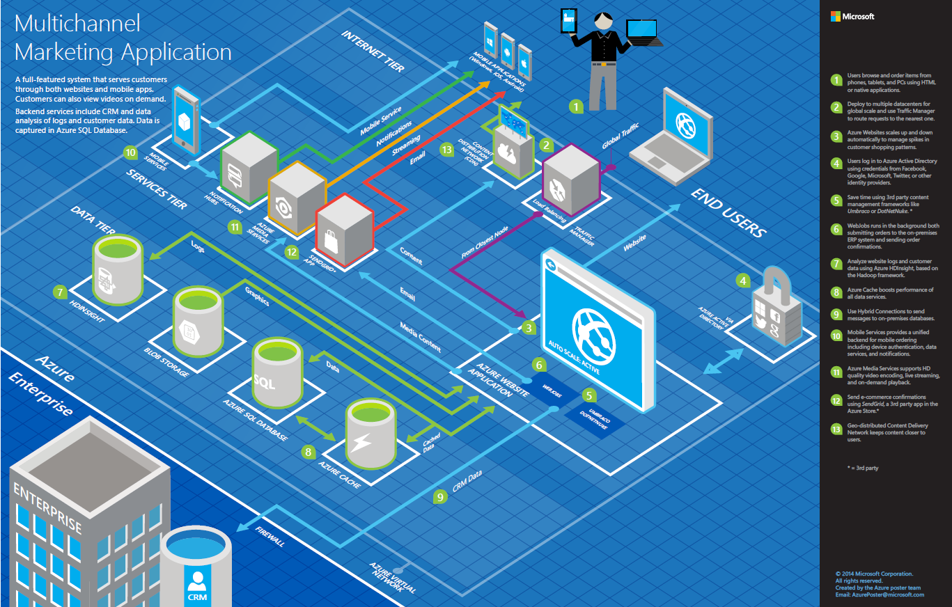

Slide 63
>57%
Greater than
1,000,000
>250k
Fortune 500 using Azure
Active websites
SQL Databases in Azure
>20
>1
TRILLION storage objects
>300
MILLION
AD users
MILLION
Developers registered with Visual Studio Online
>2
MILLION requests/sec
>13
BILLION
authentication/wk

Slide 64
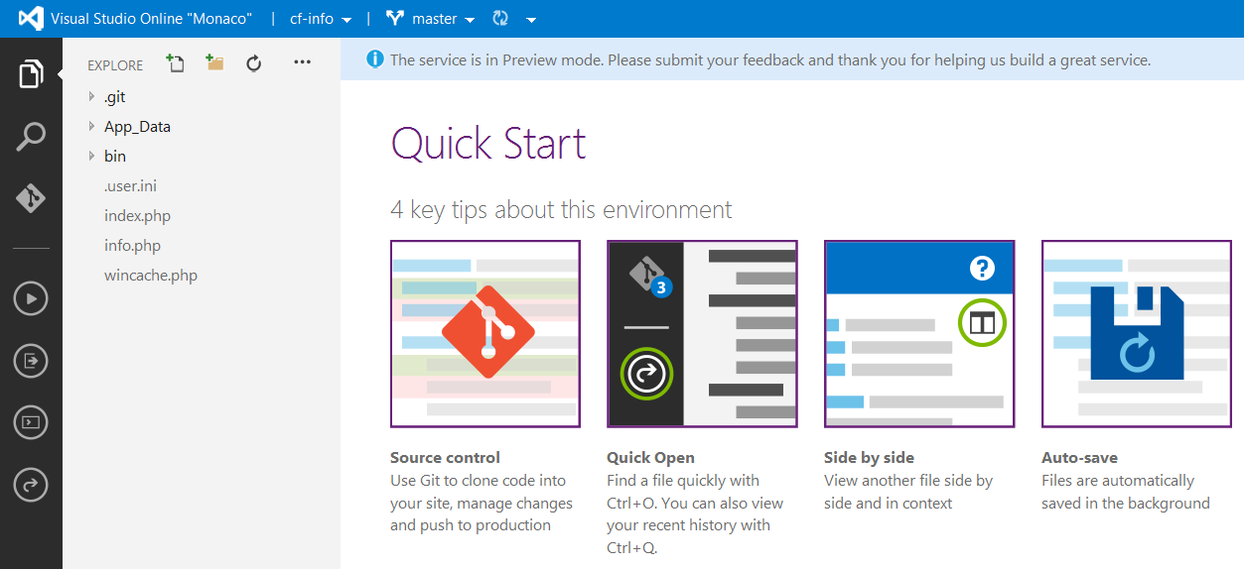
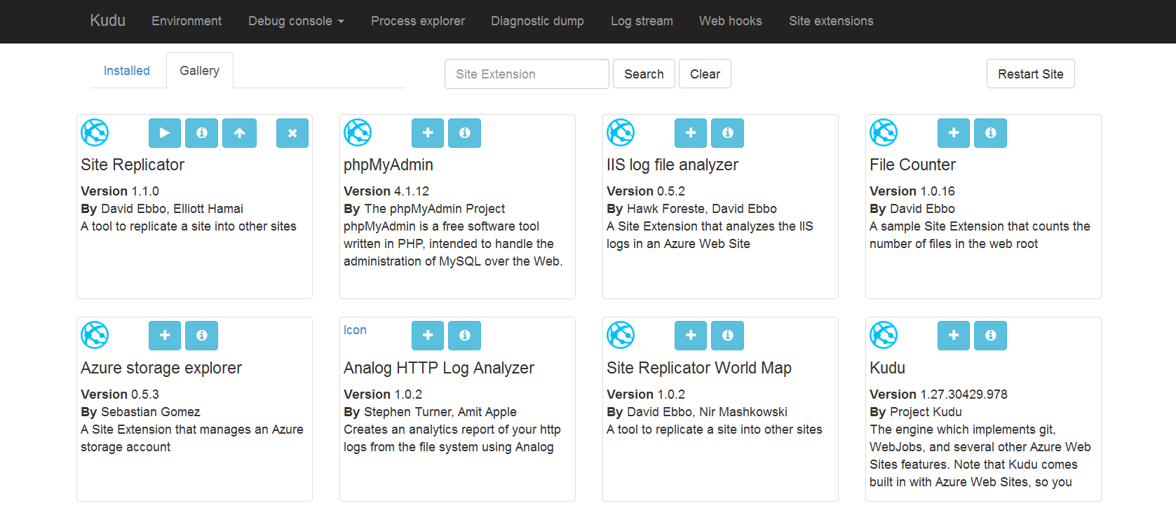
Site Extensions

Slide 65
WebSockets
Persistent Connection
Concurrent
Connections
5
35
350
Unlimited
Tier
Free
Shared
Basic / Standard
Premium

Slide 66


Web Hosting Plan
$
+
+
Azure Subscription
Pricing Tier
Geographic Region
Notes:
Web Hosting Plan is a scale unit for websites. It is comprised of a Geographic Region and a Pricing Tier within the same Azure Subscription. When you scale a site to either Basic or Standard all of the sites within the Web Hosting Plan will be placed on the same Virtual Machine.

